Slide 1

Visualize Response Data to Inform Business Decisions
A project by Open Avenues
and Businessolver

Slide 2

Reminder: share slides links and start recording!

Slide 3
Agenda
Introductions [15 min]
Project idea [10 min]
Project benefits [5 min]
Communications and project norms [5 min]
Next steps [5 min]
OA pre-project survey [10 min]

Slide 4
Introductions

Slide 5
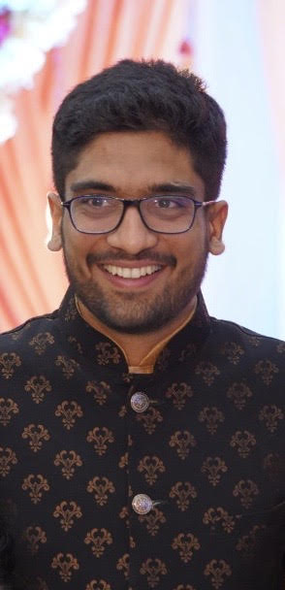
Project team
Jainik Majmudar (He/Him)
Business Intelligence Engineer, Businessolver
Business Intelligence Fellow, OA
LinkedIn: https://www.linkedin.com/in/jainikmajmudar
Email address: jainik.majmudar@openavenuesfoundation.org

Slide 6
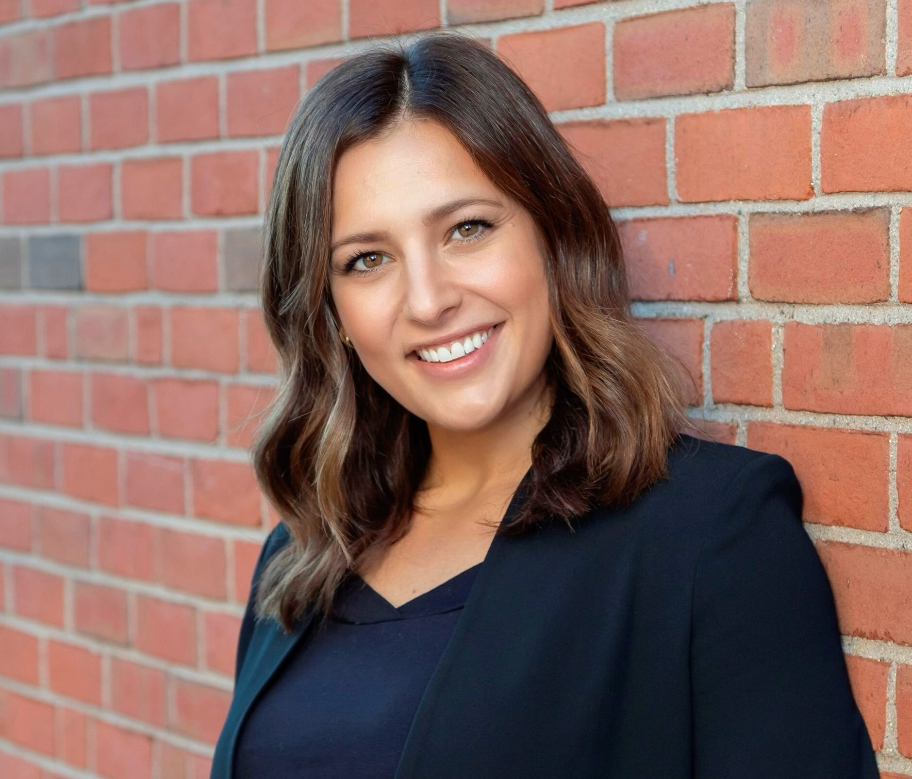
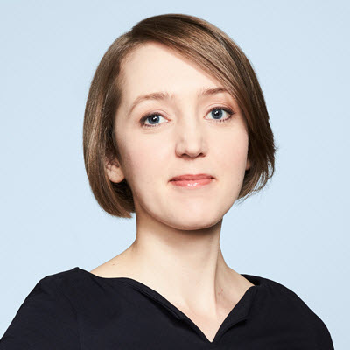
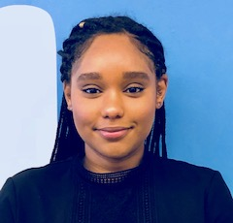
Open Avenues Team
Danielle Goldman (she/her/hers)
Co-Founder & Executive Director,
Open Avenues
danielle@openavenuesfoundation.org
LinkedIn
Elena Semeyko (she/her/hers)
Director of STEM Education,
Open Avenues
elena@openavenuesfoundation.org
LinkedIn
Rua Hamid (she/her/hers)
STEM Education Coordinator,
Open Avenues
rua@openavenuesfoundation.org
LinkedIn

Slide 7

About Open Avenues (OA)
Open Avenues is an educational nonprofit that offers students to participate in industry projects led by experts from high-growth STEM companies.
Our goals:
Help you to strengthen your resume/LinkedIn profile for future internships/job search.
Connect you to industry experts and prospective companies.

Slide 8
Let’s get to know each other!
What’s your name and pronouns?
Where’re you from?
What’s your experience with Business Intelligence/Data Analytics Field, or SQL and Python tool?
What are your hobbies?
What do you do to recharge?
Have you every participated in internships / industry projects?
What is your next career goal (find an internship, part-time job, full-time job, etc.)?

Slide 9
Project idea

Slide 10

Visualize Response Data to Inform Business Decision
We would be working on Customer Support on Twitter dataset which is a large, modern corpus of tweets and replies.
We would check, analyze and understand the pattern and conversations, and for study of modern customer support practices and impact.
Using the data, we would be analyzing and building interactive visualization to make business decision.

Slide 11
Project deliverables
Main deliverable: Create a slide deck or python notebook document to tell the data story of the customer data.
Success criteria:
A working notebook: The code works correctly with the provided dataset and well documented
Cleaned dataset and analysis that you build should be uploaded to our shared folder
The write-up clearly explains the project findings and the presentation includes all required analysis
If you have time, you can also create the python dashboard.

Slide 12
An example of a project deliverable
https://github.com/majmudar/CarAd_Ukraine_Analysis
https://github.com/nainil5560/Uber_Dataset

Slide 13

Any questions?

Slide 14
What we'll do week by week
Week 1: Introduction and Project description
Week 2: Exploratory data analysis and Preparing a portfolio project
Week 3: Data cleaning and Preparing your resume and LinkedIn profile
Week 4: Data Visualization methods and How to stand out from the crowd
Week 5: Create an interactive visualization to tell the story and insights and Interviewing
Week 6: Polishing and documenting your portfolio and Networking & finding a job
Office hours and 1:1 meetings: contact me via email to schedule them.

Slide 15

Project Plan
Project Plan is your one-stop-shop for all information related to this project.
Does this link work for you?

Slide 16
Project Roles
If you were a Project Leader, what would you expect from students joining your project?
 | Project Leader | Students
Defining the overall project goal and deliverables
Formulating tasks to perform week by week
Making sure all tasks are clear and time estimates are reasonable
Performing individual work
Setting and following deadlines
Communicating any questions and setbacks

Slide 17
Any questions?

Slide 18
Tech stack
Do you plan to join project meetings through a laptop or mobile phone?
How reliable is your Internet connection?
Will you use Mac/PC for this project?
Have you installed Anaconda (Jupyter Notebook)?

Slide 19
Group chat
Between meetings, let's use this space on Slack to discuss your project- and career-related questions.
To join the group chat on Slack, accept the invitation that you received via email from Rua Hamid.

Slide 20
Project benefits

Slide 21
Project benefits: industry insights
Get career tips and Q&A sessions with the Project Leader
Get an opportunity to ask your questions to an HR and/or a hiring manager

Slide 22

Project work
Industry insights

Slide 23
Project benefits: strengthen your LinkedIn profile
After successful project completion:
Add the project to your LinkedIn profile (follow these guidelines)
Get skill endorsements & recommendations (depending on your performance)

Slide 24
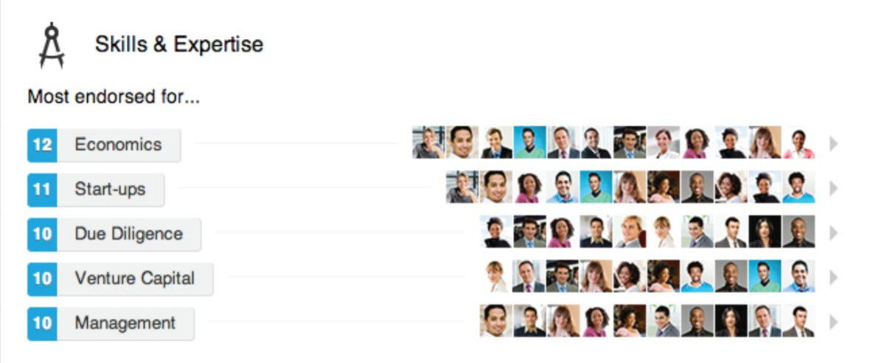
Image source: LinkedIn Profile Checklist for College Students [PDF, 1.43 Mb]

Slide 25
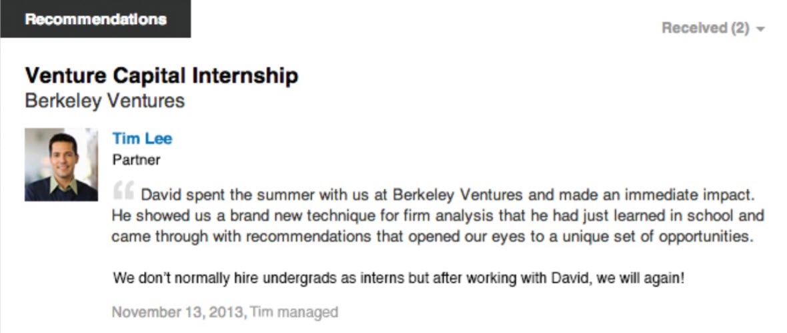
Image source: LinkedIn Profile Checklist for College Students [PDF, 1.43 Mb]

Slide 26
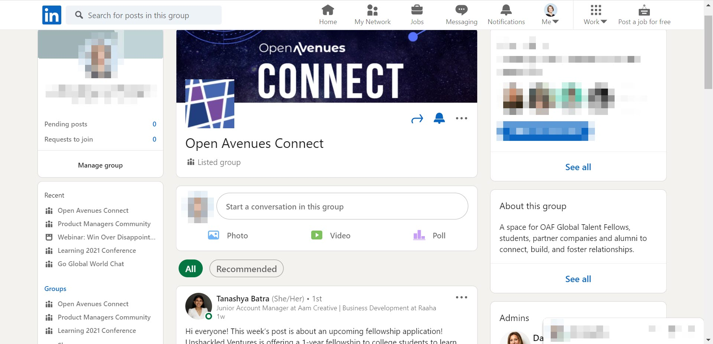
Project benefits: access to OA’s LinkedIn group
Join Open Avenues Connect to:
Network with OA partner companies and industry experts
Learn about new industry projects run by OA
Learn about internship and job opportunities offered by our partner companies

Slide 27
Stipend payments
This micro-internship includes a stipend paid to students upon the project completion through Parker Dewey.
Before the project end, sign on Gig Wage, Parker Dewey's payments partner (for links and instructions, check emails from Parker Dewey).

Slide 28
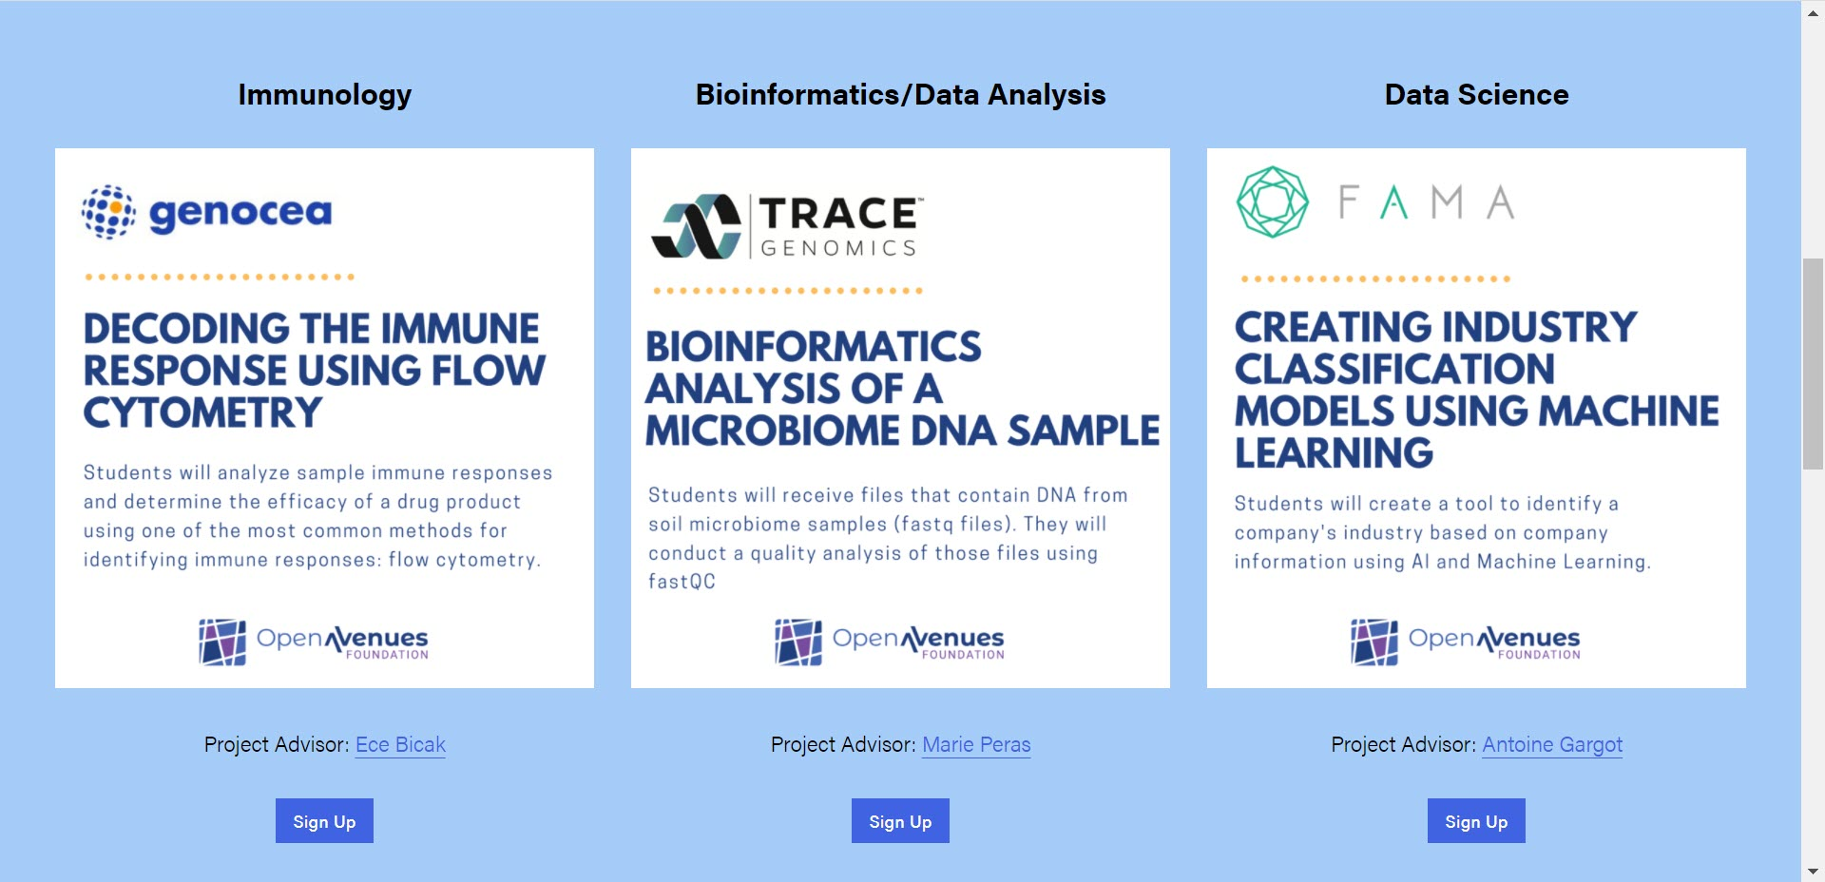
Project benefits: participate in future micro-internships run by OA
Join paid 6-8-week projects with OA partner companies
Examples: https://www.openavenuesfoundation.org/micro-internships

Slide 29
Any questions?

Slide 30
Project norms, next steps

Slide 31
Project norms
Be respectful to each other.
Project sessions, office hours, 1:1 meetings:
RSVP on calendar invites in advance
Be on time or let me know in advance if you cannot join
Cameras:
That’s OK to switch your camera off if you need to, but I’d appreciate seeing you!
Please switch the camera on when you speak
Work outside of the meeting time:
Between project sessions, you’re expected to work independently on the weekly assignments.
Contact me if you have questions / struggle to understand something. Most likely, other students have similar questions, and everyone will benefit from bringing them up!
If you cannot complete the work on time, let me know upfront!
If you cannot join a group session, contact me and we'll figure out how you can catch up.

Slide 32
Communication norms
Regular communication: let’s commit to reply to each other’s messages within 48 hours.
Urgent messages:
If you have last-minute questions, reach out to me via jainik.majmudar@openavenuesfoundation.org or slack
What’s your commitment for urgent situations?
No communication: let’s agree that if I don’t receive a reply to two consequent messages within 48 hours each, that means you’re not interested in the project = decided to drop off.

Slide 33
Let's connect on LinkedIn!
In the chat, post a link to you LinkedIn profile
Connect to each other
Connect to the project team
Jainik Majmudar: https://www.linkedin.com/in/jainikmajmudar/
Elena Semeyko: https://www.linkedin.com/in/elena-semeyko-62986b5a
Rua Hamid: https://www.linkedin.com/in/rua-hamid-137b29121
Join Open Avenues Connect group

Slide 34
Next steps
Before the next session
Individual work:
Important to complete on time:
Python and Jupyter notebook installation
Create a few points on your understanding and explanation of each column
Create a few points on your understanding of the data
Understanding the term Data Exploration
Optional: Try to connect the data into Jupyter notebook
Career development:
[5-10 min] Create a LinkedIn profile if you don’t have one
In the next session, be ready to share a link to your profile with me and other students
[5 min] Review my LinkedIn profile and be ready to ask me questions about it
[15 min] Prepare a brief description of your project role – how you want it to appear on your LinkedIn profile after all work is done. Be ready to share that description in the next session.

Slide 35
Example of a project role description
Completed a software development Industry Project for Self, Inc.
• Successfully set up a Python environment and worked through the functions provided.
• Developed a working model of basic retirement calculator and created a graphical representation of savings vs spending over the years.
• Performed regression testing to ensure the system worked as intended.
General recommendations
Be brief and specific
Use active verbs

Slide 36
Contact us
Project work
Jainik Majmudar: jainik.majmudar@openavenuesfoundation.org | https://www.linkedin.com/in/jainikmajmudar
Groupchat: https://join.slack.com/share/enQtNDc4OTk1OTY5ODg4MC01ZGM1MjFjODU0MGFhNmFmOGFmOGFlYjU1ODcxN2FiYjMyM2M3OGI4MDZlZTgzNmI4YTUyMWExYmFjOTlkZDA5
Any OA-related questions
Rua Hamid: rua@openavenuesfoundation.org | LinkedIn
Elena Semeyko: elena@openavenuesfoundation.org | LinkedIn
For anonymous questions and feedback, use this form: https://forms.office.com/r/iRzaP4yLQZ

Slide 37
Any questions?

Slide 38
OA pre-project survey
We’d like to learn more about your background and project expectations!
Please complete this survey:
Student Pre-Project Survey [10 min] https://forms.office.com/r/Tk0mX06gsD

Slide 39
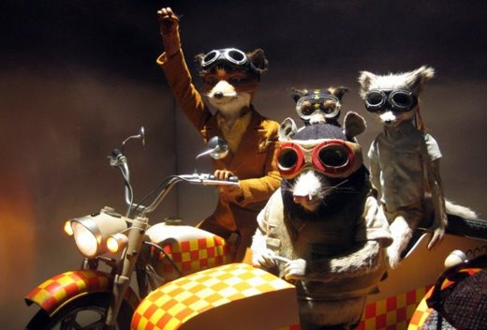
Group photo!

